Slide 2
Java 8 Basics
JAVA 8 is a major feature release of JAVA programming language development.
Its initial version was released on 18 March 2014.
With the Java 8 release, Java provided supports for functional programming, new JavaScript engine, new APIs for date time manipulation, new streaming API, etc.

Slide 3
New Features
Lambda expression − Adds functional processing capability to Java.
Method references − Referencing functions by their names instead of invoking them directly. Using functions as parameter.
Default method − Interface to have default method implementation.
New tools − New compiler tools and utilities are added like ‘jdeps’ to figure out dependencies.
Stream API − New stream API to facilitate pipeline processing.
Date Time API − Improved date time API.
Optional − Emphasis on best practices to handle null values properly.
Nashorn, JavaScript Engine − A Java-based engine to execute JavaScript code.

Slide 4
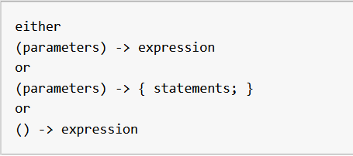
Lambda Expression
In Java programming language, a Lambda expression (or function) is just an anonymous function, i.e., a function with no name and without being bounded to an identifier.
They are written exactly in the place where it’s needed, typically as a parameter to some other function.
The basic syntax of a lambda expression is:

Slide 5
Rules for writing lambda expressions
A lambda expression can have zero, one or more parameters.
The type of the parameters can be explicitly declared or it can be inferred from the context.
Multiple parameters are enclosed in mandatory parentheses and separated by commas. Empty parentheses are used to represent an empty set of parameters.
When there is a single parameter, if its type is inferred, it is not mandatory to use parentheses. e.g. a -> return a*a.
The body of the lambda expressions can contain zero, one or more statements.
If body of lambda expression has single statement curly brackets are not mandatory and the return type of the anonymous function is the same as that of the body expression. When there is more than one statement in body than these must be enclosed in curly brackets.

Slide 6
Streams
Streams are an update to the JAVA API that lets you manipulate the data in a declarative way.
You can think of them as an iterator over a collection of data.
Streams can be processed in parallel transparently without you having to write any multithreaded code

Slide 7
Suppose you want to write a program that returns the dishes name
in sorted order whose calorie value is greater than 400.

Slide 8
Working with streams
With streams one can perform various operations on the data.
The most commonly used operation is :
Filtering and Slicing

Slide 9
Filtering with a predicate
Question: What is predicate?
Answer: A predicate is a function which returns a Boolean.(true/false)
Example: If a particular condition is met then the predicate will return true otherwise it will return false.
Filter method takes predicate as an argument
Example:
List.stream.filter(predicate<T>)
List.stream.filter(dish->dish.getCalorie()>400)
This will return all the dishes object whose calorie > 400

Slide 10
Filtering unique elements
Streams also support a method called “distinct” (just like SQL)
Distinct returns a stream with unique elements

Slide 11
Truncating a stream (limit)
Stream contains a unique method called limit(n)
The limit(n) returns another stream which is not longer than the given size n.
Limit is intermediate In nature

